Slide 1
TPMS Tool F01 Upgrade process
FARTEC GROUP
AUG 27, 2019
Video Links: https://youtu.be/L4_P8rKn2EM

Slide 2
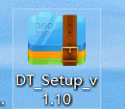


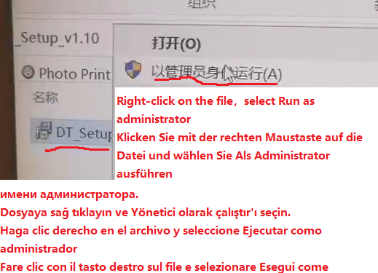
1.Unzip the upgrade client(The DT setup V1.10 file is in technical support of www.farsensor.com)
Unzip the file →
Open →
2. Right-click the file,select Run as administrator and install the file.

Slide 3
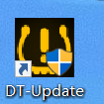
3.Find the client on desktop or your computer and open it.

Slide 4
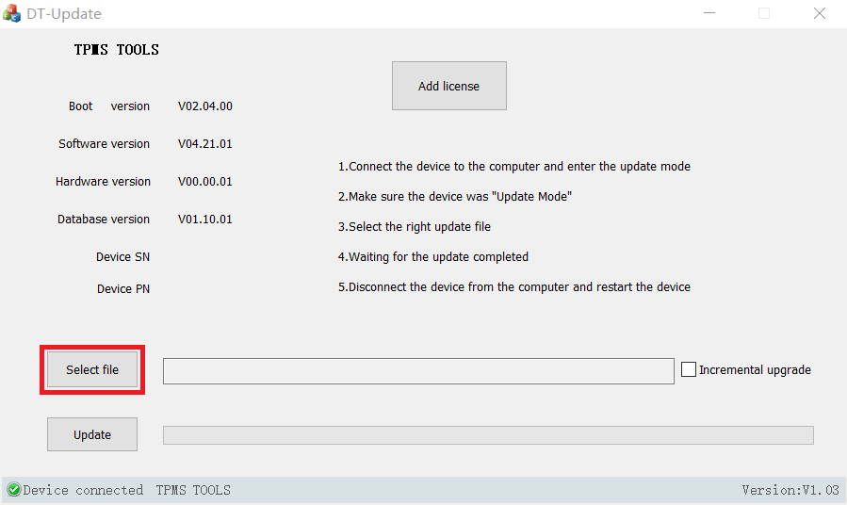

Slide 5
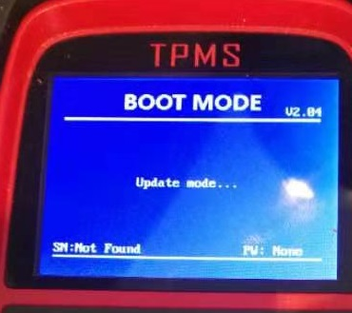
4. Power on F01 tool, find “Update equipment” in Setting and connect it to computer.

Slide 6
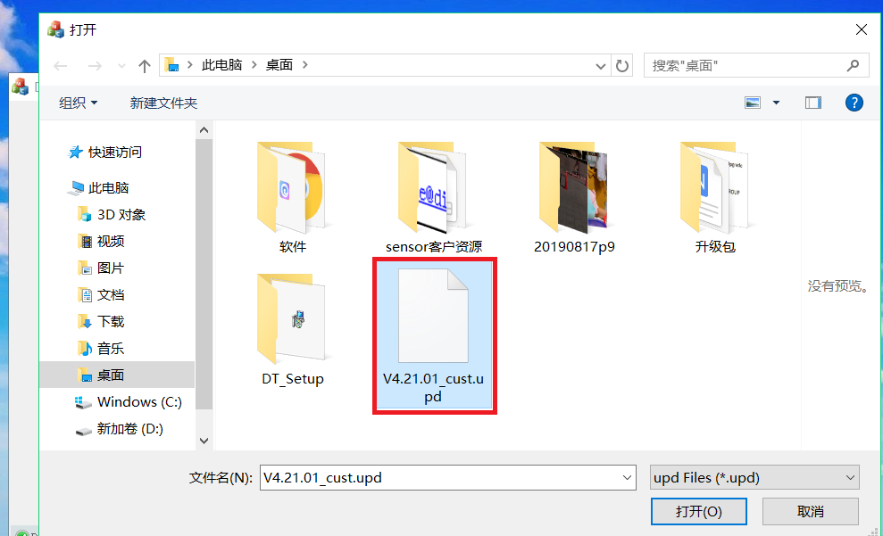
5. Select the upgraded software in your computer and click update.

Slide 7
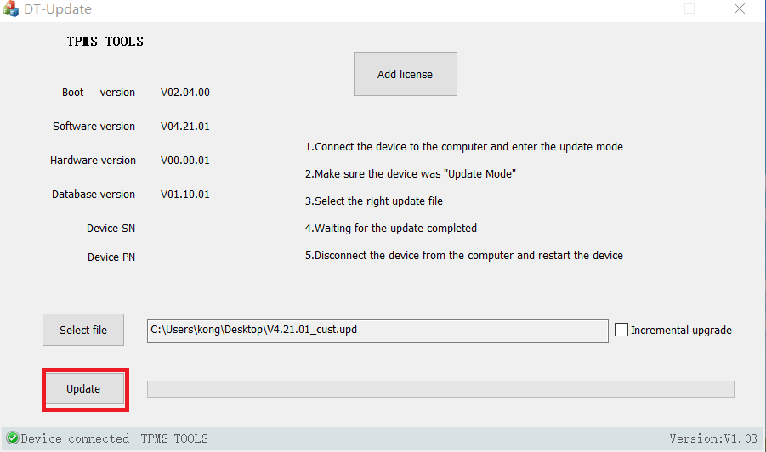

Slide 8
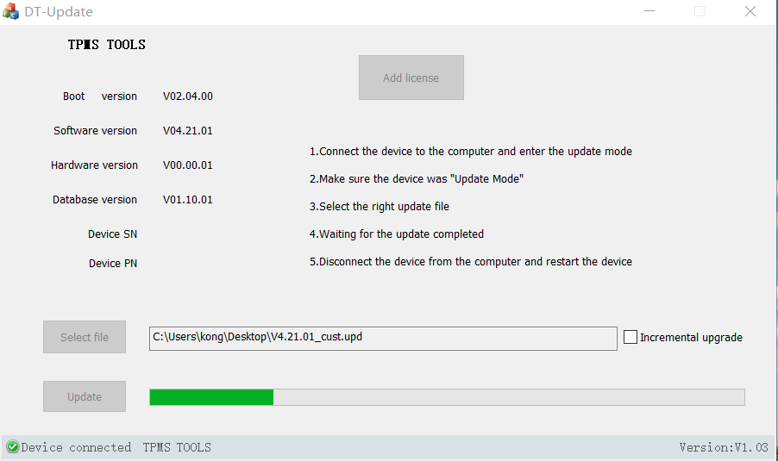
6. Plug out the tool and computer from USB after update ended

Slide 9
